Slide 1
Integrated, Dynamic Activity-Network Simulator: Current State and Future Directions of PCATS-DEBNetS
Ryuichi Kitamura, Akira Kikuchi
Kyoto University, Japan
and
Ram M. Pendyala
Arizona State University
Innovations in Travel Modeling 2008
Portland State University
June 22-24

Slide 2
Philosophy Behind Development*
Integrated, concurrently and interactively executed, activity and dynamic network simulators
Activity simulator PCATS
Network simulator DEBNetS (need a new name)
Activities and trips generated along the time axis; trips are loaded on the network as they are generated.
Prism and other constraints → enhanced realism
Simple decision models
Sequential, past-dependent structure
Utilization of existing data base
Household travel survey results
Populated by synthetic households
Well verified, empirically tested model components
*See Reference (1) through (10)

Slide 3
Motivations for the Alternative Approach
Problems with trip-based analysis when applied to TDM evaluation:
No time of day,
No linkage between trips,
Mode choice dominates as a result, and
Can accommodate only a limited range of policy measures.
Needs to evaluate the effectiveness of a wide range of measures for sustainability as well as efficiency
Needs to assess the impacts of measures on urban residents’ equity and quality of life
Drastically different scenarios for the future, e.g.,
Declining population, insufficient road funds
Exploding gasoline prices
Increasing importance of behavioral modification measures
An integrated micro-simulation model of daily travel is the way to go.

Slide 4
The Approach
Micro-simulation of individuals’ daily travel
Gain realism by incorporating:
space-time (prism) constraints
constraints on modal transition, public transit availability, etc.
Treat work/school schedules as given and fixed
Discretionary activities simulated along the time axis based on household travel survey results
Dynamic interface and concurrent execution, along the time axis, of the activity simulator and a network simulator
No post-processing of model outputs
Other capabilities being incorporated (more later):
Inter-individual interactions to better represent household behavior, route choice, civic decision, etc.
Point (quasi-continuous) representation of urban space
Integrating micro-scale network simulator into the meso-scale simulator
Hägerstrand’s Constraints School
Chapin’s Activity-pull (Needs and Desires) School

Slide 5
PCATS: A Micro-Simulator of Daily Travel
Stands for “Prism Constrained Activity-Travel Simulator”
Divides a day into open periods and blocked periods.
Defines a Hägerstrand’s prism for each open period and simulates activities and travel within it.
Use of synthetic households to simulate the urban population
Sequential structure
The attributes of an activity and trip to it are simulated activity by activity, conditional on past activity engagement.
Operational hierarchy: activity type → mode-destination → activity duration
Representation of prism constraints
Activity choice ← remaining time in prism
Mode-destination choice ← choice set
Duration choice ← remaining time in prism

Slide 6
Simulation of Activities and Travel in a Hägerstrand’s Prism
Time
Activity 2 (Fixed)
Activity at
Location A
Activity 2
1
Activity 1
v
Home Activity
Activity 1 (Fixed)
A
Home
Work
Urban Space
June 24, 2008
BOKU Course 856 306 Topic 5
6

Slide 7
PCATS: A Micro-Simulator of Daily Travel
Stands for “Prism Constrained Activity-Travel Simulator”
Divides a day into open periods and blocked periods.
Defines a Hägerstrand’s prism for each open period and simulates activities and travel within it.
Use of synthetic households to simulate the urban population
Sequential structure
The attributes of an activity and trip to it are simulated activity by activity, conditional on past activity engagement.
Operational hierarchy: activity type → mode-destination → activity duration
Representation of prism constraints
Activity choice ← remaining time in prism
Mode-destination choice ← choice set
Duration choice ← remaining time in prism

Slide 8
Decision Time Points for Discretionary Activities
Decision Point 1
Decision Point 2
Decision Point 3
Activity 1
Activity 2
Fixed Activity
Travel
Travel
Travel
Time
Open Period
Blocked Period

Slide 9
PCATS: A Micro-Simulator of Daily Travel
Stands for “Prism Constrained Activity-Travel Simulator”
Divides a day into open periods and blocked periods.
Defines a Hägerstrand’s prism for each open period and simulates activities and travel within it.
Use of synthetic households to simulate the urban population
Sequential structure
The attributes of an activity and trip to it are simulated activity by activity, conditional on past activity engagement.
Operational hierarchy: activity type → mode-destination → activity duration
Representation of prism constraints
Activity choice ← remaining time in prism
Mode-destination choice ← choice set constrained by prism
Duration choice ← remaining time in prism

Slide 10
PCATS Model Components*
Prism vertex models
Stochastic frontier models to determine unobserved prism vertices⁽¹¹⁻¹³⁾
Activity type choice models
Multinomial logit models that determine activity engagement in each open period.
Destination-mode choice models
Nested-logit models that assign a destination-mode pair within the prism to each activity.
Activity duration models
Split-population survival models that determine the length of each activity while considering the prism size.
Demographic simulator HAGS
Populates traffic zones with synthetic households, then ages them through the horizon year.
* All models are specified for workers, non-workers, and students/pupils.

Slide 11
Representing Prism Constraints
In-home Activity
A prism configured assuming the fastest travel mode in the choice set
Time
Travel mode availability by time of day and mode continuity checked within and across prisms
Prism vertices generated by stochastic frontier models
PM Work Activity
AM Work Activity
1
In-home Activity
v
Home
Work
Urban Space

Slide 12
HAGS Components
Household Attribute Generation System (HAGS)
Predecessor: MIDAS⁽¹⁴⁻¹⁵⁾
Household Distributor
Applies IPF and determines the joint distribution of household attributes by zone, based on base-year marginal and joint distributions, then clones households according to the joint distribution thus generated for each zone.
Household Ager
Simulates the evolution of households by generating: birth, death, marriage, divorce, employment and residential relocation; given these, vehicle ownership is determined; license holding based on a simple cohort model.
Fixed Activity Generator⁽¹⁶⁾
Determines the beginning and ending of fixed activities (work and school) for each worker or student.

Slide 13
Network Simulator DEBNetS
Stands for Dynamic Event-Based Network Simulator.
A link is divided into short segments, in which traffic flow is assumed as uniform.
A meso simulator: Flow speed in each segment is estimated based on a speed-density relationship, while bookkeeping is done at the vehicle level.
Probabilistic route assignment
Auto trips loaded as they are generated by PCATS
Commercial and external trips in background
Vehicular emissions estimated based on speed by vehicle type for each link
A simple network editor developed using Google Maps API program

Slide 14
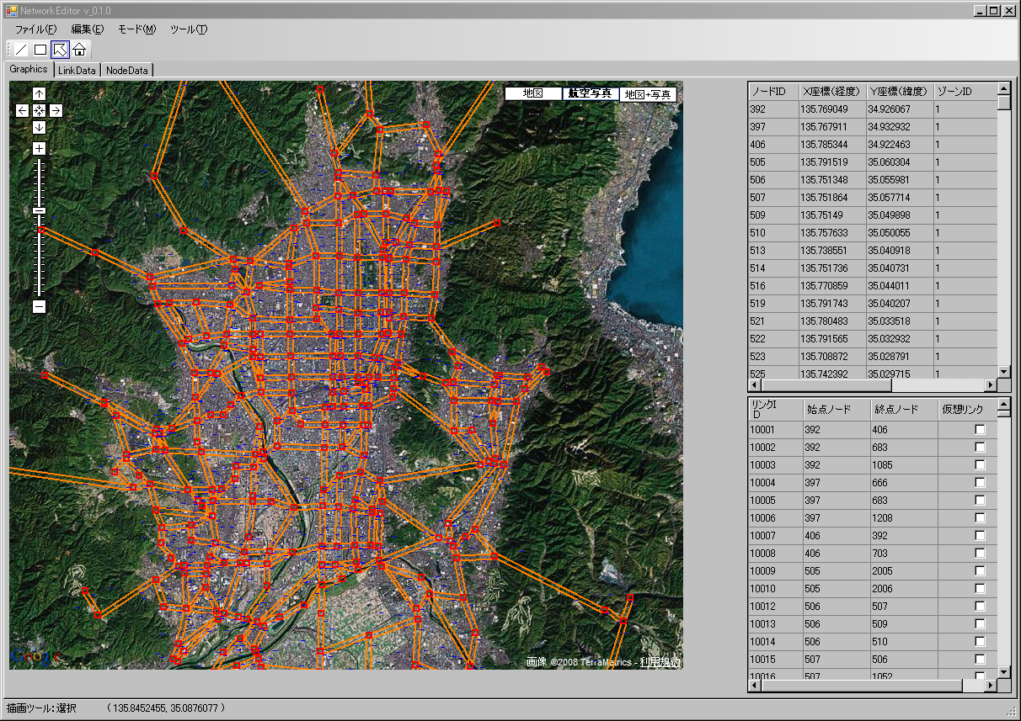
Google Map-based Network Editor

Slide 15
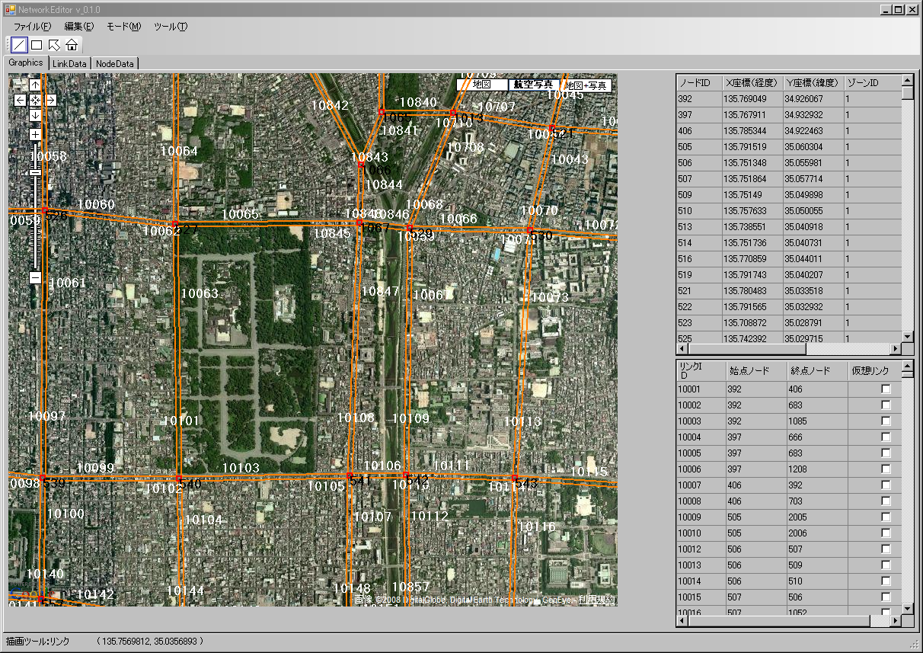

Slide 16
Mechanism of Activity Generation: Original PCATS
Open Period Begins
Prism Constraints
No
Time Left for Activities?
Yes
Prism Constraints
Prism Constraints
Mode Choice to
Next Fixed Activity
Activity Type Choice
Destination-Mode Choice
Prism Constraints
Mode Choice (to Fixed Activity)
Activity Duration Choice
Adjust Activity Duration
Yes
Prism Constraints
No
More Activities?
Open Period Ends

Slide 17
Processing Multiple Agents
Simulate decisions by the first agent on the process waiting list
Event Manager
Simulate network traffic
Traffic Simulator
Execute till the first activity of the agents on the actor list ends.
Execution termination time?
Can first agent start a new activity in the prism?
Prism Enforcer
Place the agent on the process waiting list with a flag indicating the next activity

Slide 18
Working of the Integrated Activity-Network Simulator
Activity Timer
Activity Time
Event Manager
Simulates activity time and duration
Travel Time, Mode
Processes agents on the process waiting list
Activity Type
Generator
Simulates activity type
Select destination-mode
OK
Trip Ends
Trip Starts
Prism Enforcer
Activity Complete
Traffic Simulator
Determine feasibility of the trip

Slide 19
Three Prime Processors of the System
Decision Processor
Determine destination and mode
Given arrival time, determine
activity duration
Decision to engage in some activity
Decision to engage in some activity
Agent on Process Waiting List
Event Manager
Activity duration
Scanning Interval (1”)
Agent on Actor List
Traffic Simulator
Time Axis
Travel
Agent on Traveler List

Slide 20
Integrated Activity-Network Simulator: Issues
Explicit time axis
PCATS generates activities along the continuous time axis.
Trips are loaded onto the network as they are generated.
Exact trip durations are not known until the trips are completed.
Problems of unmet mobility
An agent may be late for work, cannot run an errand, cannot return home, etc.
Prism constraints may not always be satisfied.
Activity-travel decisions are made, as is the case in reality, without knowing exactly how long it may take to a potential destination.
Model travelers’ perceptions/anticipations?

Slide 21
Proposed Countermeasures
Incorporating models of schedule modification
Current PCATS applies the same activity type and duration models, whether prism constraints are binding or not.
Develop models of activity modification that apply when prism constraints are (or, appear to be) binding.⁽¹⁷⁾
Incorporating models of learning
Repeat PCATS/DEBNetS simulation for a number of days and let the agent learn how to schedule and modify activities and travel
Laboratory experiments to obtain data for modeling
Leading to the representation of:
Behavioral modification (under worsening congestion, under a new TDM measure, etc.)
Day-to-day variability

Slide 22
Is the Sequential Decision Structure Adequate?
No representation of “look ahead” aspects in decision
Limited policy sensitivity
Do “simultaneous” models of daily behavior better represent human decision?
Simon and Kahneman and Tversky and Slovic and many many others do not think so.
Our verbal protocol analysis suggests repeated human decisions are entirely different from what rational decision models depict.
Models that do not represent decision processes properly may exhibit erroneous sensitivities, even when they replicate observation well.
Alternative decision mechanisms needed?
Probably. For example, models of inductive learning.
Again, laboratory experiments to obtain data for modeling

Slide 23
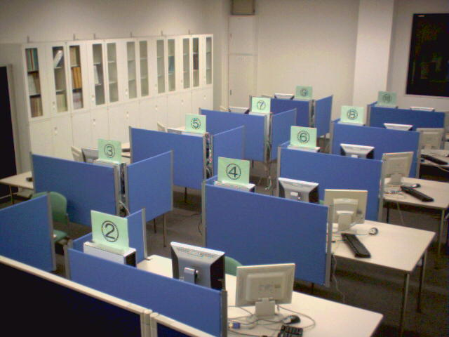
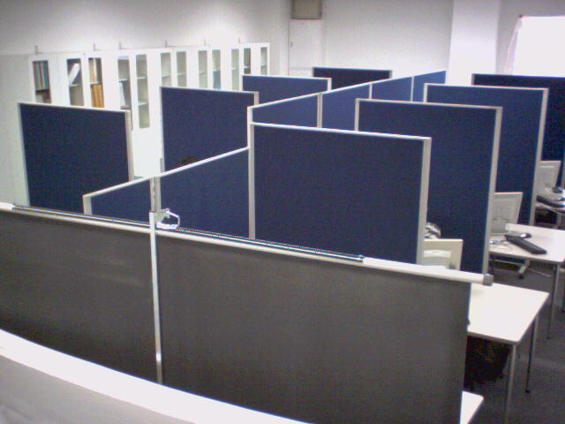
Man-Machine Simulation Lab at Kyoto University

Slide 25
Working of Experimental Data Collection Process with Subjects + Computer Agents
PCATS Server Program
Agents
Experimenter
Problem
Subjects’ Inputs
Collective
Results
Ethernet
Client Program
Client Program
Client Program
Subject
Subject
Subject

Slide 26
Ongoing and Proposed Extensions
Inter-personal interactions
Household behavior
Route choice
Social dilemmas
Behavioral modification
Quasi-continuous urban space
10 m x 10 m gridcells with MCMC⁽¹⁸⁾
Incorporation of individual establishments, parking lots, etc.
Representation of parking location choice
Better representation of walk and bike trips
Better representation of transit access/egress
The agent should have attitude⁽¹⁹⁻²⁰⁾—HAGS extension

Slide 27
Extensions (cont.)
Incorporating commute trip departure time choice⁽²¹⁻²⁵⁾
Safety margin
Travel time bandwidth (perceived travel time variation)⁽²⁶⁾
Incorporating route choice behavior⁽²⁷⁻²⁹⁾
Representing variations in value of time and other idiosyncrasy
Embedding a micro-simulator within the meso-simulator
For representation of detailed traffic engineering measures, etc.
Incorporation of micro-emissions functions (like the ones in MOVES)

Slide 28
Examples of Application Areas
Spatial-temporal distribution of people and activities
Disaster management
Evaluation policy measures in terms of time use utility⁽³⁰⁾
A measure of quality of life
Equity analysis: how costs and benefits of a policy measures are distributed across people
Emissions and air quality analysis
Effects of cold starts and trip chaining
Peak-spreading and emissions of smog precursors
Traveler profiles on network links

Slide 29
Percent of Workers on Street by Time of Day

Slide 30
Percent of Commuters on Karasuma St. by Sex and Time of Day

Slide 31
Percent of Commuters on Outer Ring by Sex and Time of Day

Slide 32
Percent of Drivers over 60 on Karasuma St. by Sex and Time of Day

Slide 33
Percent of Drivers over 60 on Outer Ring by Sex and Time of Day
Time of Day

Slide 34
Evolution of PCATS
Version 1.0
Fortran77
Kyoto U. Mainframe
City of Kyoto (COP 3)
Kyoto-Osaka-Kobe
Metropolitan Area
Version 1.1
C
Linux
City of Kyoto, City of
Osaka, City of Toyota,
The Netherlands
Version 2.0
C
Linux
City of Kyoto (quasi-
continuous urban space
with MCMC algorithms)
Version 1.2
C
Windows
City of Osaka
Version 2.1
C
Windows
State of Florida
(MCMC, stochastic
frontier models)
Version 3.0
C, C#
Windows
City of Kyoto (PCATS
network simulator
integration)

Slide 35
Evolution of DEBNetS
Version 1.0
Fortran77
Kyoto U. Mainframe
City of Kyoto (COP 3)
Kyoto-Osaka-Kobe
Metropolitan Area
Version 1.1
Fortran77
Linux
City of Kyoto
City of Osaka
Version 2.0
C
Sun OS, Linux
Model validation
City of Osaka
Version 2.1
C
Sun OS, Linux
City of Osaka (trip table
estimation routine)

Slide 36
Bibliography
1. Kitamura, R., C.V. Lula and E.I. Pas (1993) AMOS: An activity‑based, flexible and truly behavioral tool for evaluation of TDM measures. Proceedings of Seminar D, 21st PTRC Summer Annual Meeting, PTRC Education and Research Services Ltd., London, pp. 283-294.
2. Kitamura, R., E.I. Pas, C.V. Lula, T.K. Lawton and P.E. Benson (1996) The sequenced activity mobility simulator (SAMS): An integrated approach to modeling transporta­tion, land use and air quality. Transportation, 23(3), 267-291.
3. Pendyala, R.M., R. Kitamura, C. Chen and E.I. Pas (1997) An activity-based microsimulation analysis of transportation control measures. Transport Policy, 4(3), 183-192.
4. Kitamura, R. and S. Fujii (1998) Two computational process models of activity-travel behavior. In T. Gärling, T. Laitila and K. Westin (eds.) Theoretical Foundations of Travel Choice Modelling, Pergamon Press, Oxford, pp. 251-279.
5. Pendyala, R.M., R. Kitamura and D.V.G.P. Reddy (1998) Application of an activity-based travel-demand model incorporating a rule-based algorithm. Environment and Planning B, 25, 753-772.
6. Kitamura, R., S. Fujii, T. Yamamoto and A. Kikuchi (2000) Application of PCATS/DEBNetS to regional planning and policy analysis: Micro-simulation studies for the Cities of Osaka and Kyoto, Japan. In the Proceedings of Seminar F, European Transport Conference 2000, pp. 199-210.
7. Kitamura, R., C. Chen, R.M. Pendyala and R. Narayanan (2000) Micro-simulation of daily activity-travel patterns for travel demand forecasting. Transportation, 27(1), 25-51.
8. Arentze, T., A. Borgers, F. Hofman, S. Fujii, C. Joh, A. Kikuchi, R. Kitamura, H. Timmermans and P. van der Waerden (2001) Rule-based versus utility-maximizing models of activity-travel patterns: A comparison of empirical performance. In D. Hensher (ed.) Travel Behaviour Research: The Leading Edge, Elsevier Science, Oxford, pp. 569-583.
9. Kitamura, R., A. Kikuchi, S. Fujii and T. Yamamoto (2005) An overview of PCATS/DEBNetS micro-simulation system: Its development, extension, and application to demand forecasting. In R. Kitamura and M. Kuwahara (eds.) Simulation Approaches in Transportation Analysis: Recent Advances and Challenges, Springer, New York, pp. 371-399.
10. Pendyala, R.M., R. Kitamura, A. Kikuchi, T. Yamamoto and S. Fujii (2005) The Florida Activity Mobility Simulator (FAMOS): An overview and preliminary validation results. Transportation Research Record, 1921, 123-130.
11. Kitamura, R., T. Yamamoto, K. Kishizawa and R.M. Pendyala (2000) Stochastic frontier models of prism vertices. Transportation Research Record, 1718, 18-26.

Slide 37
12. Pendyala, R.M., T. Yamamoto and R. Kitamura (2002) On the formation of time-space prisms to model constraints on personal activity-travel engagement. Transportation, 29(1), 73-94.
13. Kitamura, R., T. Yamamoto, Y.O. Susilo and K.W. Axhausen (2005) How routine is a routine? An analysis of the day-to-day variability in prism vertex location. Transportation Research A, 40(3), 259-279.
14. Goulias, K.G. and R. Kitamura (1992) Travel demand forecasting with dynamic micro­simulation. Transportation Research Record, 1357, 8‑17.
15. Goulias, K.G. and R. Kitamura (1997) Regional travel demand forecasting with dynamic microsimulation models. In T.F. Golob, R. Kitamura and L. Long (eds.), Panels for Transportation Planning: Methods and Applications, Kluwer Academic Publishers, Dordrecht, pp. 321-348.
16. Kitamura, R., C. Chen and R.M. Pendyala (1997) Generation of synthetic daily activity-travel patterns. Transportation Research Record, 1607, 154-162.
17. Chen, C., T. Gärling and R. Kitamura (2004) Activity rescheduling: Reasoned or habitual? Transportation Research F, 7(6), 351-371.
18. Yamamoto, T., R. Kitamura and K. Kishizawa (2001) Sampling alternatives from colossal choice set: Application of Markov Chain Monte Carlo algorithm. Transportation Research Record, 1752, 53-61.
19. Kitamura, R., P.L. Mokhtarian and L. Laidet (1997) A micro-analysis of land use and travel in five neighborhoods in the San Francisco bay area. Transportation, 24(2), 125-158.
20. Kitamura, R. and K. Sakamoto (2008) Worldviews, lifestyle and sustainability: A search for a primordial determinant of environmental friendliness. Submitted to Transportation Research D (under review).
21. Fujii, S. and R. Kitamura (2004) Drivers’ mental representation of travel time and departure time choice in uncertain traffic network conditions. Networks and Spatial Economics, 4, 243-256.
22. Senbil, M. and R. Kitamura (2004) Reference points in commuter departure time choice: a prospective theoretic test of alternative decision frames. ITS Journal, 8(1), 19-31.
23. Senbil, M. and R. Kitamura (2004) Heterogeneity in commuter departure time decision: A prospect theoretic approach. In N.O. Attoh-Okine and B. Ayyub (eds.) Applied Research in Uncertainty Modeling and Analysis, Kluwer Publishers, pp. 369-398.

Slide 38
24. Jou, R.-C. and R. Kitamura (2008) Commuter departure time choice: A reference-point approach. Transportation Research A, 42 (forthcoming).
25. Senk, P. and R. Kitamura (2008) How do commuters know when to leave home? A verbal protocol analysis of cognitive processes. Transportation Research Record (forthcoming).
26. Kitamura, R., A. Kikuchi, K. Ushiwaka and P. Senk (2008) Travel time bandwidth: An operational measure of perceived travel time variability. Submitted to Transportation Research F (under review).
27. Nakayama, S. and R. Kitamura (2000) A route choice model with inductive learning. Transportation Research Record, 1725, 63-70.
28. Senbil, M. and R. Kitamura (2007) WTP and WTA for expressway services. In S.H. Oda (ed.) Developments on Experimental Economics: New Approaches to Solving Real-World Problems, Lecture Notes in Economics and Mathematical Systems Vol. 590, Springer Verlag, Berlin, pp. 143-148.
29. Senbil, M. and R. Kitamura (2008) Policy effects on decisions under uncertainty: Simulation with mixed logit models of toll expressway users. Transportation Research Record (forthcoming).
30. Kitamura, R., T. van der Hoorn and F. van Wijk (1997) A comparative analysis of daily time use and the development of an activity-based traveller benefit measure. In E.F. Ettema and H.J.P. Timmermans (eds.), Activity-Based Approaches to Travel Analysis, Pergamon Press, Oxford, pp. 171-188.

